Slide 1





Capstone 3
CALIFORNIA
HOUSING PRICE
By : Gian Sirait

Slide 2

Business Problems
A real estate company in California faces a major challenge in determining accurate prices for properties.
Improper pricing can lead to:
Financial losses
Lost business opportunities
Difficulty selling properties due to high prices
Inventory build-up and increased operating costs
Selling properties below true market value, leading to long-term losses

Slide 3
PROBLEM STATEMENT
01.
02.
03.
Real estate companies in California face challenges in accurately determining property prices.
Need for a solution to optimize pricing using historical data and predictive analytics
Improper pricing can result

Slide 4
ANALYTIC APPROACH
Perform exploratory data analysis to identify patterns and trends.
Create new features to enhance model performance.
Train models and evaluate using appropriate metrics.
Understanding the Dataset
Data Exploration
Data Cleaning
Feature Engineering
Model Selection
Model Training and Evaluation
Choose models like linear regression, KNN, ridge, decision tree, random forest, and XGBoost.
Study available dataset and variables affecting housing prices
Rectify missing values, outliers, and invalid data.

Slide 5




GOAL
Decision Support:
Provide actionable insights
Make the right decisions regarding
Identifying Key Factors:
Analyze the importance of various features
Determine the factors that influence changes in house prices in California
Predicting House Prices:
Develop a regression model to predict median house value based on features.

Slide 6



WHY ML ?
Accurate Predictions
Efficiency
Learn complex patterns and trends
Process large amounts of data quickly and efficiently.
Adaptability
Complex Factor Identification
Adapt to various types of data and situations.
Uncover hidden and complex pattern

Slide 7
longitude
latitude
Data Understanding
Housing Median Age
Total Rooms
Total Bedrooms
Population
Households
Median Income
Median House Value
ocean Proximity

Slide 8
DATA PREPROCESSING
Distribution Analysis
Outlier
Anomaly
Missing Value
It was found that there were outliers in the feature column. It was decided not to delete the data because it was considered important.
In the median_house_value column there are 678 data with $500,001 and median_age there are 896 data aged 52 Years.
Performing a skewness analysis found no normally distributed numerical features.
Found missing values in the total_bedrooms column, as many as 137 data points.

Slide 9
DATA PREPROCESSING
Duplicate
After performing a duplicate check, it was found that there were no duplicate rows.

Slide 10
Feature Enginering
Add New Feature
rooms_per_household : availability of space in housing
population_per_household : population to number of households
Encoding
ocean_proximmity
Scaling
Robust Scaler

Slide 11
Modelling

Slide 12
Metric
Evaluation
MAE
Mean Absolute Error (MAE) is used to measure the average absolute value of the difference between the prediction and the actual value.
MAPE measures the average percentage error of the prediction against the actual value. This metric provides an understanding of the extent to which the model can correctly predict housing prices on a percentage scale.
MAPE
R-squared indicates how well the variability in the data can be explained by the model. The closer it is to 1, the better the model is able to explain the variation in the data. By using a combination of these evaluation metrics, we can measure and understand the model's performance holistically, ensuring that the chosen model can provide accurate and reliable housing price predictions.
R2

Slide 13
BENCHMARK
MODEL
Benchmark
Model
AdaBoost
Decision Tree
KNN
Gradient Boosting
Random Forest
XGBoost
Hyper Parameter Tunning
Best Model
XGBRegressor =>
MAE : 26662.975565
MAPE : 0.146036
R-2 : 0.812424
XGBRegressor, Random Forest, Gradient Boosting

Slide 14
XGBREGRESSOR
DEFINITION
HOW IT WORK
ADVANTAGES
XGBRegressor is a boosting model that uses multiple decision trees to produce accurate predictions. Using a gradient boosting technique, it iteratively builds a new model to reduce the error of the previous model, focusing on the mistakes made by the previous models.
XGBRegressor is a machine learning algorithm used for regression tasks, which is part of XGBoost (Extreme Gradient Boosting).
This method is very efficient and can handle large datasets well.

Slide 15
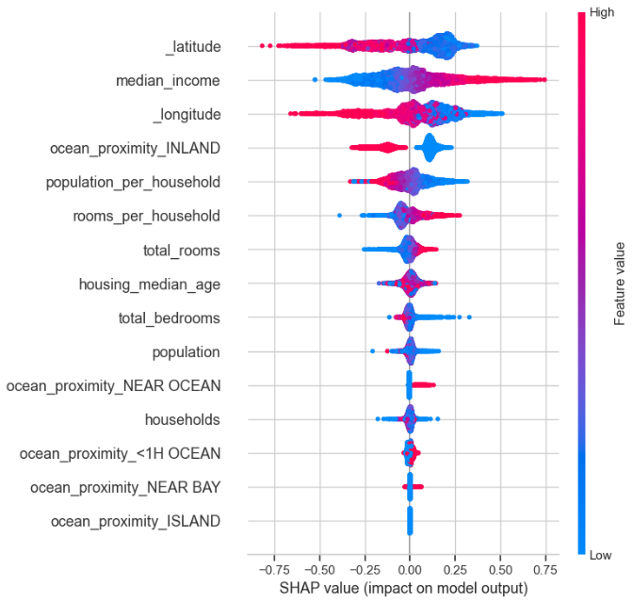
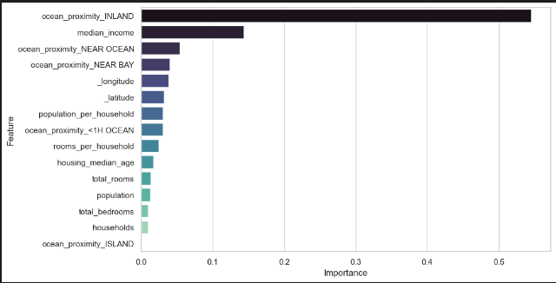
Feature Importance

Slide 16
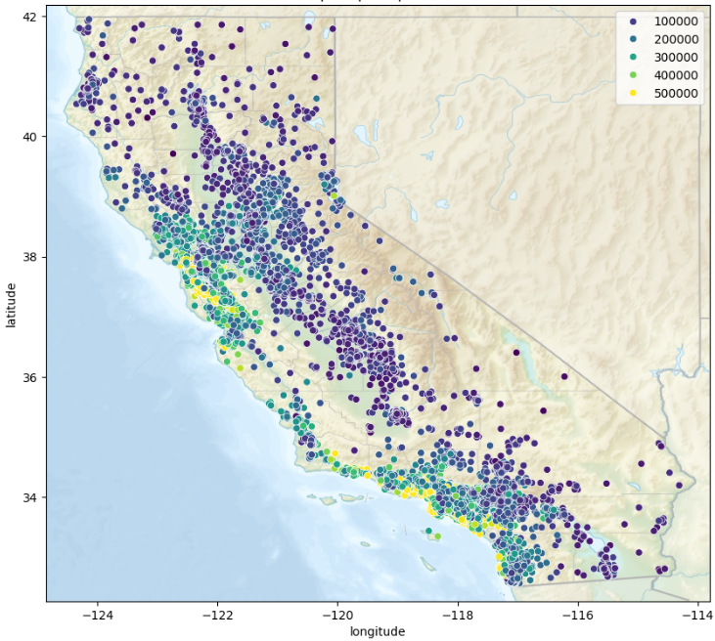
Feature Importance

Slide 17
Conclusion
MAE | MAPE | R2
26662.975565 | 14.60% | 81.24%
Pricing Strategy
Price Adjustment
Negotiation
Development of Real Estate Advisory Services
Market Analysis
Investment Consulting

Slide 18

THANK
YOU

